Slide 1
Emergence of Bangladesh
North South University
Dhaka, Bangladesh
HIS 103

Slide 2
The Battle of Palashi for Drug Money & Colonial Takeover

Slide 3
Part-1

Slide 4
The British East India Company (BEIC) was founded in 1600
The Company received a “Loyal Charter” from Queen Elizabeth 1 to trade in Indices
Initially, the focus of the Company was trade, not empire-building
Competition and conflict with the Portuguese and Dutch companies
Trading of basic commodities like salt, spices, tea, silk, opium
In 1600, the British merchants founded the British East India Company to facilitate taking part in the flourishing opium trade. The victory of Plassey in 1757 provided the British East India Company with a stronger political hold over the opium trade in Patna and the surrounding poppy growing areas.

Slide 5
In partnership with Dutch and the Portuguese, the English maritime trader initially came into the Indian Subcontinent.
The British naval exploration goes back to King Henry the VIII from 1491 to 1547
In 1613, the English merchant succeeded in securing permission from Emperor Jahangir to establish their first business base at Surat
In 1639, the BEIC established its business base in Madras
In 1690, the BEIC secured trade facilities in Kolkata from the Nawab of Bengal against the payment of Rs. 1200/-per year
In 1717, the English got the free trade access in Bengal except for paying an annual sum of Rs. 3000/- payable to imperial treasury at Hoogly.

Slide 6
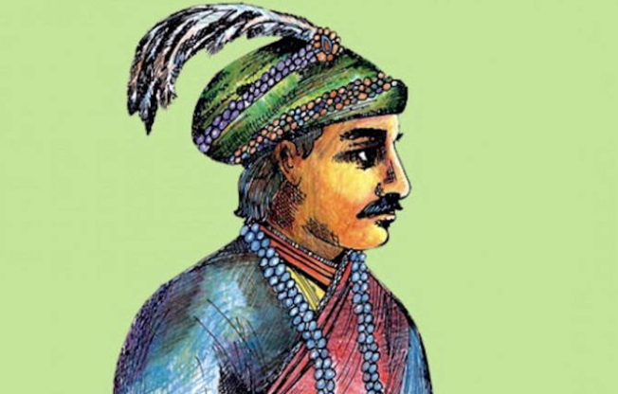

Slide 7


Slide 8
Nawab lost the battle, his life, and kingdom. Clive had around 3,000 troops and 10 small cannons against the Nawab’s 62,000 troops and 50 large cannons.
Mir Jafar and two other generals, Rai Durlabh and Yar Lutuf Khan, with 30,000 infantry and 20,000 cavalry troops, abstained from fighting after a few hours when Clive’s victory was imminent and inevitable. With 62,000 troops the Nawab should have won the battle before Mir Jafar and two other generals decided to remain inactive. The Nawab also had the support of a small French infantry and artillery. At the end of the day, Clive’s and his officer’s military genius, and his troops’ advanced training, discipline, and valour, along with the Company’s military organization, not Mir Jafar’s (and Rai Durlabh’s and Yar Lutuf Khan’s) treachery sealed the fate of the Nawab.

Slide 9
The debacle came soon after the Nawab’s troops and artillery had managed to push Clive and his men to a defensive position in the mango grove of Plassey. By noon, suddenly a heavy rainstorm engulfed Plassey and surrounding areas, turning the Nawab’s artillery totally ineffective. While Clive’s troops covered their guns and gunpowder with tarpaulins to protect them from the rainstorm – which lasted for a couple of hours – the Nawab’s army had no such contingencies. Their guns being totally useless with rain-soaked gunpowder, the Nawab lost the battle.

Slide 10
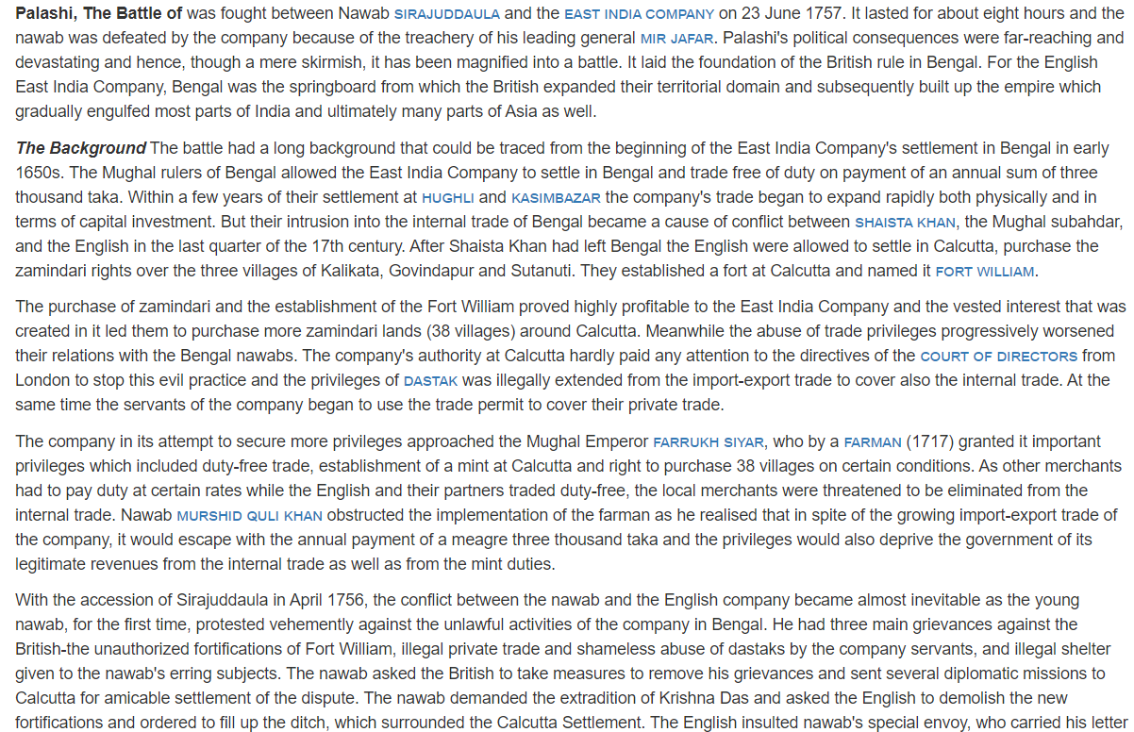

Slide 11
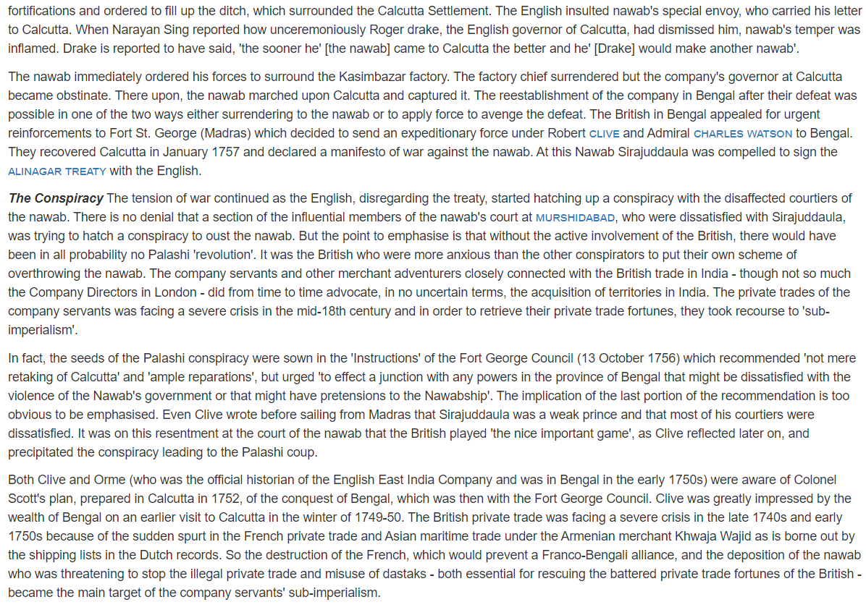

Slide 12
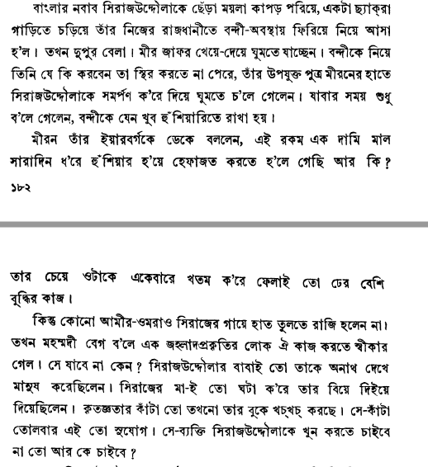
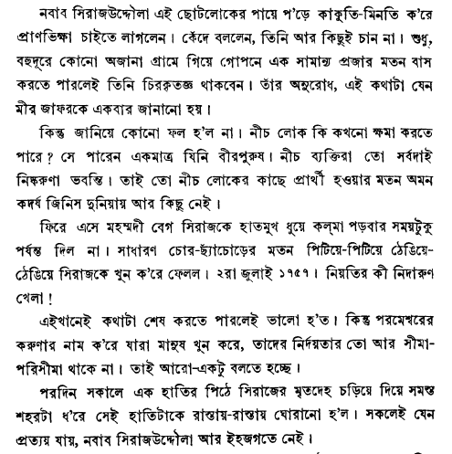

Slide 13
Regulating Act, 1773:
BEIC’s corruption and nepotism
Financial crisis
Famine of 1770 (ছিয়াত্তরের মন্বন্তর)
Robert Clive’s dual rule (the company had Diwani rights in Bengal while the Nawab had Nizamat rights (judicial and policing rights) as secured from the Mughal Emperor)
BEIC’s victory and the defeat of Mir Kashim in the Battle of Buxer of 1764

Slide 14
The Regulating Act of 1773:
The regulating Act of 1773 was passed by the British Parliament to control the territories of the East India Company majorly in Bengal. This act was passed due to the misgovernment by the British East India government that introduced a situation of bankruptcy and the government had to interfere with the affairs of the Company.

Slide 15
Main Provisions of the Regulating Act of 1773:
This act permitted the company to retain its territorial possessions in India but sought to regulate the activities and functioning of the company.
The act provided for the appointment of a Governor-General along with four Councillors in the Presidency of Fort William (Calcutta), jointly called the Governor-General in Council. Warren Hastings was appointed as the Governor-General.
The company directors were elected for a period of five years and one-fourth of them were to retire every year. Also, they could not be re-elected.
A supreme court was established in Calcutta. Judges were to come from England.

Slide 16
Part-2

Slide 17
Abul Fazl, the historian of Akbar’s time and the writer of the Akbarnamah claimed that poppy was one of the most valuable crops and an important source of revenue during the time of Akbar. Between 1653 and 1708, opium was one of the exportable commodities of the Mughal kingdom. Given the varied information, it is difficult to arrive at a conclusion that the Mughals had any monopoly in the opium trade .
MUGHAL DRUG POLICY

Slide 18
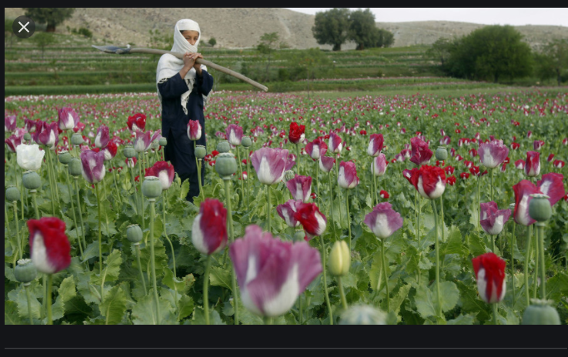
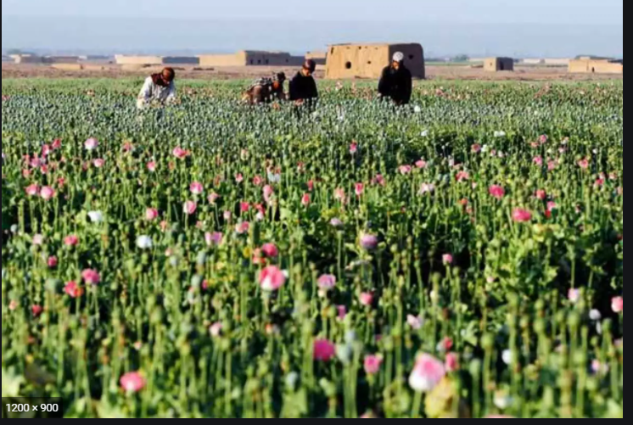

Poppy cultivation

Slide 19
British colonial drug policy 1. At the time of growth and development of the opium monopoly in Bengal from 1773 to 1856, the economic condition of the poppy farmers (ryots) had deteriorated and tension had erupted between the local zamindars (landlords) and the colonial authorities. This conflict aided in the eventual uprising of 1857, also known as the Indian 'Sepoy Mutiny’. In an attempt to further control the private cultivation of opium poppies and the free trade in opium, the government adopted the Opium Act of 1857 and the Opium Act of 1878. 2. The colonial drug laws applied a double standard, as they allowed the imperial authorities to appropriate revenue from the state-run opium monopoly, while pushing the private traders to become involved in the contraband trade. 3. The Indian opium trade flourished until the late nineteenth century, when China emerged as a major market for the supply of opium from India Thus, the history of the drug trade in Asia has a complex political background with numerous cross-regional connections.

Slide 20

Golden Triangle

Slide 21
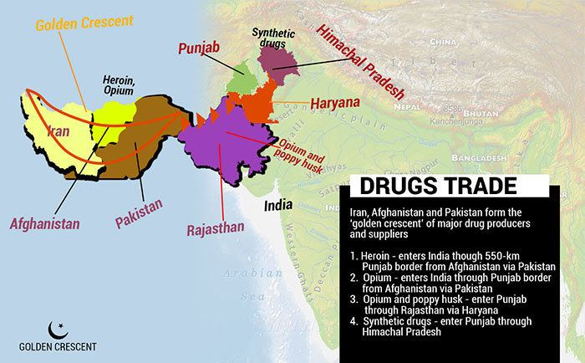
Golden Crescent

Slide 22
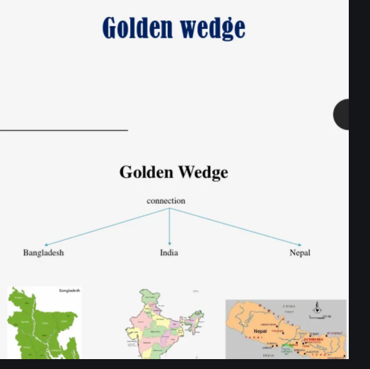

Slide 23
The Arab physicians, who had learnt the medicinal application of opium (Papaver Somniferum) from the Greeks, came in contact with India from the eighth century AD. In collaboration with Dutch, Portuguese and then the English trading companies, a group of private traders evolved in sporadic poppy cultivation in some parts of India in the sixteenth and seventeenth centuries. With the establishment of political rule, the British East India Company eventually expelled all other parties from the opium trade and came in conflict with the local zamindars that attempted to resist the large scale conversion of fertile land into poppy cultivation. This rift eventually contributed to the great uprising of 1857 in the poppy growing areas
Bengal opium traffic 1773-1856

Slide 24
To organize the opium enterprise, the government of the East India Company in 1763 established the so-called 'Gentlemen's monopoly' run by the Patna Council. It consisted of Company officials, who entered the business directly and distributed money through Indian agents (gumastas) amongst farmers to grow opium poppies. The employees received their salaries from the profits they made individually in the opium monopoly.

Slide 25
Business consortium in opium: In an attempt to establish a business consortium in opium, the East India authorities in 1765 allowed other European companies to participate in a joint venture under one general agent. Malpractice and corruption of officials affected this system,when the respective companies started to 'trade clandestinely on their own account in the drug. INCREASE OF POPPY LAND CULTIVATION: Under the joint venture, the land under poppy cultivation was increased from 283,000 hectares in 1765-6, to 303,500 hectares in the following year. This large-scale conversion of paddy fields into poppy cultivation contributed to a famine in Bengal in 1770. This famine caused the death of 10 million people in an area that had been traditionally known as the 'Golden Bengal' due to its natural resources.

Slide 26
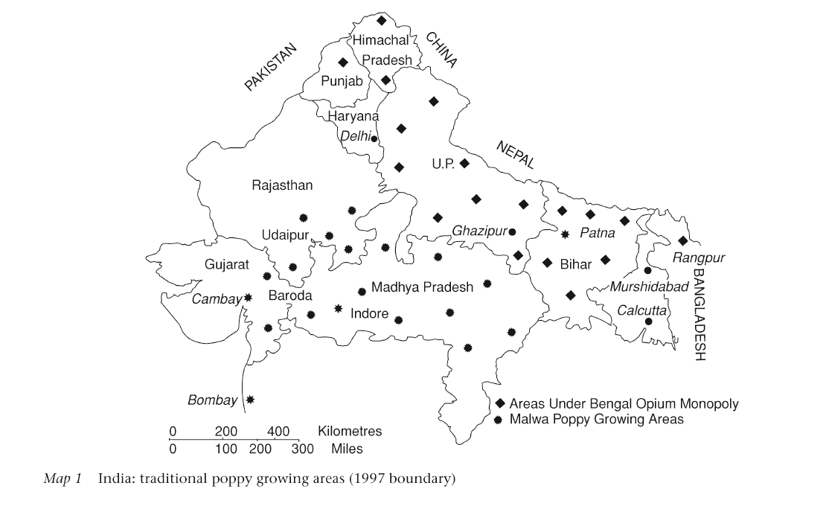
Poppy Growing Areas

Slide 27
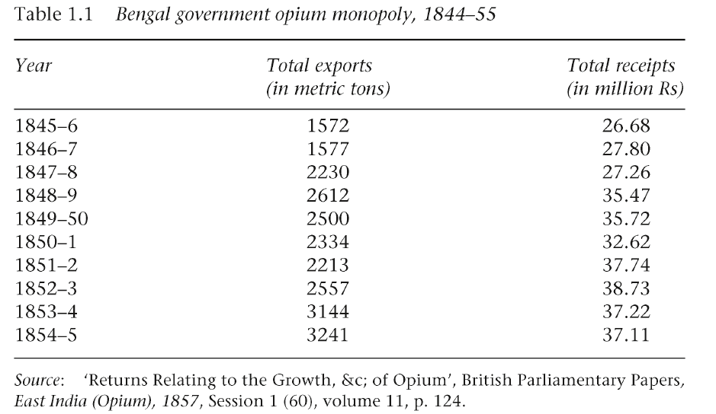

Slide 28
References (Books):
Tapanmohan Chottopadhai, Polashir Juddo
M. Emdadul Haq, Drugs in South Asia

Slide 29
Questions and Answers

